Slide 1
Status of the ITK Toolkit
Hans J. Johnson

Slide 2
Where are We?

Slide 3
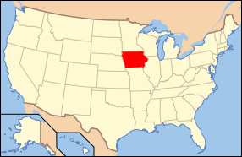
Where are We?

Slide 4
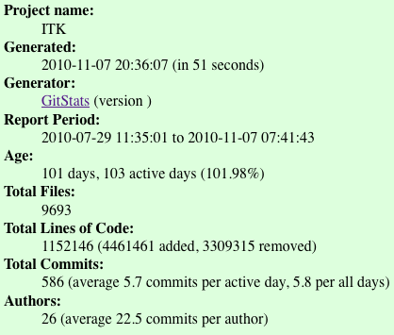
./gitstats/gitstats -c commit_begin=5f6b8ec8de1967a364a0bb2d476455b1e99564c9 \
-c commit_end=HEAD ~/Dashboard/src/ITK ITKv4_Report

Slide 5
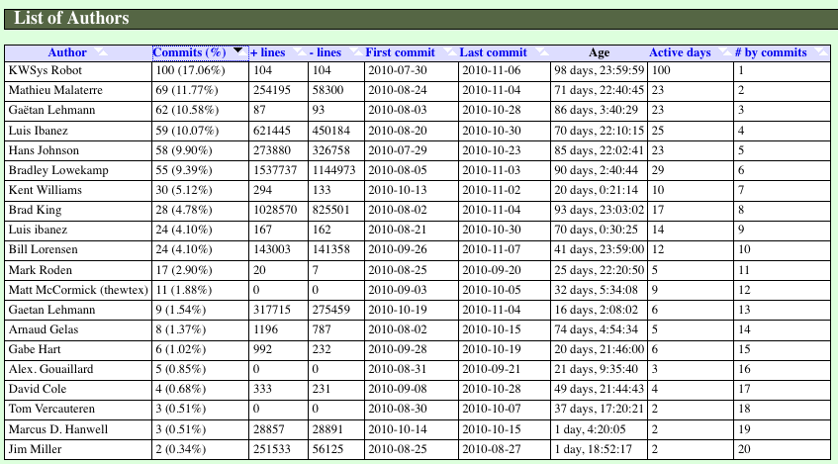
Who?

Slide 6
Who?

Slide 7
What? File Types (All of ITK)
Results produced by gitstats tool
Total lines of text in Git1,152,146

Slide 8
Source Code Chart

Slide 9
ITK Code by the Numbers
 | Code | Testing | Examples
SLOC (logical) | 198635 | 109750 | 22918
Exec. Instructions | 132602 | 84117 | 15301
Data Declarations | 44632 | 14856 | 4189
Comments | 149605 | 37150 | 39776
Blank Lines | 72766 | 39994 | 15013
Files | 2707 | 1195 | 331
Numbers generated with USC Unified CodeCount (UCC)

Slide 10
Interesting Keyword Prevalence
Compiler Directives |  | Data Keywords |  | Executable Keywords
#define | 3440 | class | 14660 | dynamic_cast | 584
#error | 9 | const | 25898 | reinterpret_cast | 124
#pragma | 1532 | const_cast | 630 | typeid | 400
#undef | 281 | explicit | 9 | goto | 311
#include | 17708 | friend | 53 | static_cast | 3411
#using | 0 | register | 17 | cout (Code) | 212
 |  | volatile | 10 | cerr (Code) | 170
 |  | virtual | 4228 | cin (Code) | 2

Slide 11
Difference since ITKv4
 | Number of Lines
New Lines | 13086
Deleted Lines | 28260
Modified Lines | 73807
Unmodified Lines | 111742

Slide 12
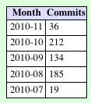
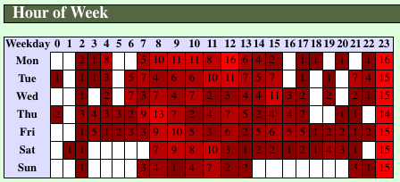
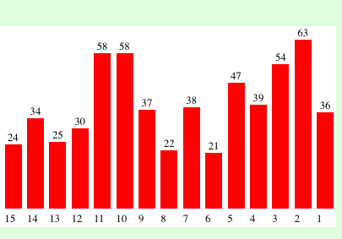
When? Git Commits

Slide 13
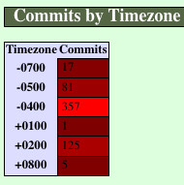
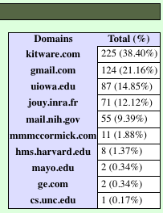
Where?
NOTE: Time Zones were not configured properly, so this is shifted

Slide 14
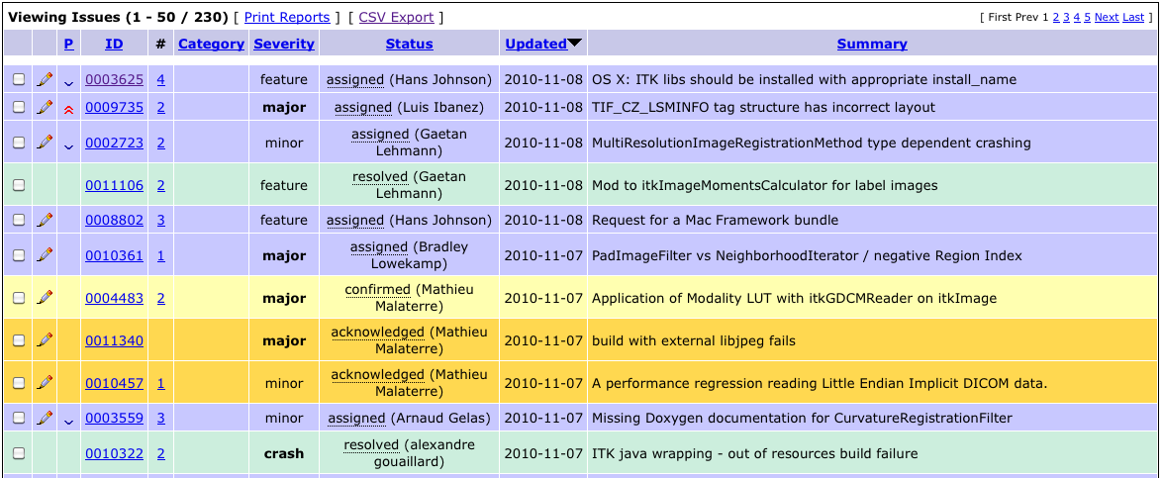
Why?

Slide 15
Days Inactive Dormant
: : mean : mean
Who : How : days: days
:many : open: inactive
==========================================
Jim Miller : 14 : 1604 : 1004
Bill Lorensen : 10 : 774 : 717
Luis Ibanez : 115 : 1075 : 633
Gaetan Lehman : 14 : 589 : 385
Not assigned : 34 : 340 : 318
Matthew McCormick : 25 : 556 : 81
Bradley Lowekamp : 12 : 300 : 74
Hans Johnson : 13 : 295 : 17
Xiaoxiao : 8 : 1108 : 14
Bill Hoffman : 1 : 49 : 10
Alex Gouaillard : 8 : 291 : 9
Brian Avants : 5 : 501 : 5
Stephen Aylward : 5 : 824 : 4
Gabe Hart : 8 : 318 : 3
Kentwilliams : 24 : 443 : 2
Nick Tustison : 1 : 140 : 2
Mariusstaring : 1 : 134 : 2

Slide 16
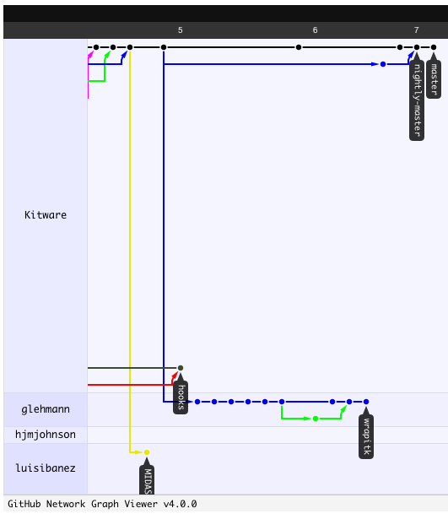
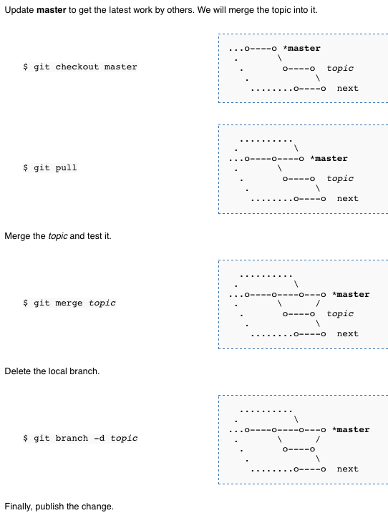
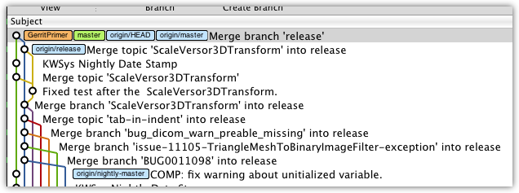
How? Git

Slide 17
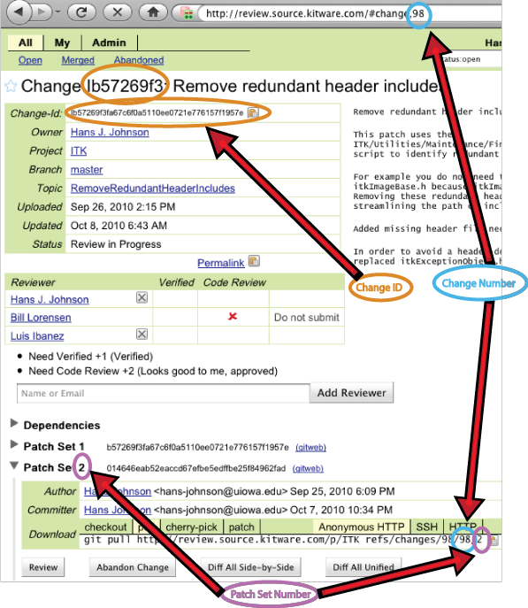
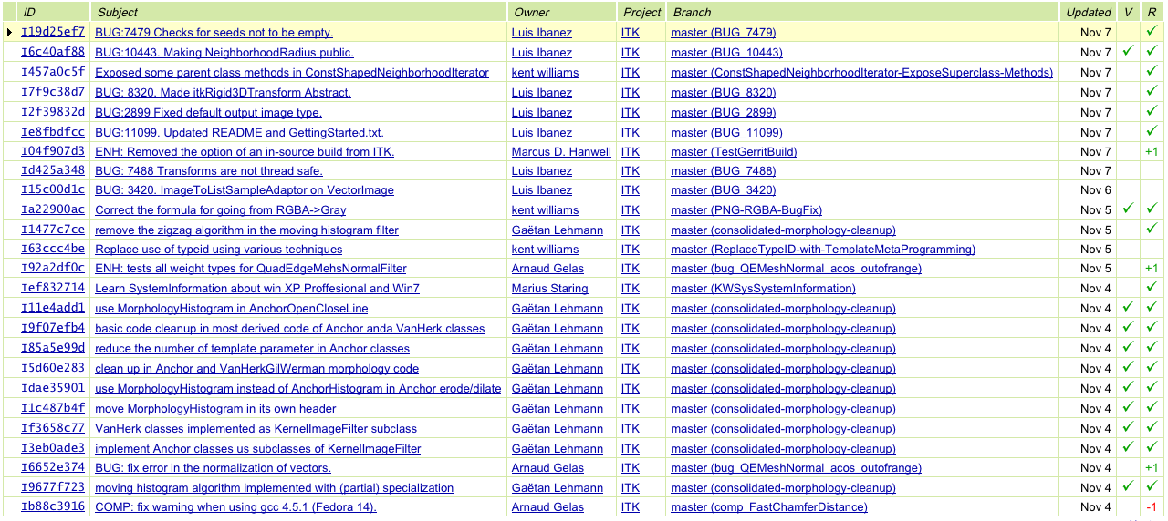
How? Gerrit

Slide 18
Discussion Points
Unified logins and Integrated systems
Git
Gerrit
Wiki
Mantis
?Midas?
These tools need to be less distinct
GitHub
NITRC
NAMIC (Sandbox)
NAMIC (Wiki)
Slicer3/4 (Wiki)
Slicer3/4 (svn)

