Slide 1
In-Situ Visualization with the ParaView Coprocessing Library
November 14, 2010
Kenneth Moreland Nathan Fabian
Sandia National Laboratories
Andrew Bauer Pat Marion
Kitware Inc.
SAND 2010-6270P
Sandia is a multiprogram laboratory operated by Sandia Corporation, a Lockheed Martin Company, for the United States Department of Energy’s National Nuclear Security Administration under contract DE-AC04-94AL85000.
Notes:
As we progress, please feel free to interrupt with questions.

Slide 2
Tutorial Materials
SC10 Tutorial USB Memory Stick
SC10 ParaView Coprocessing Tutorial Wiki Page
http://www.paraview.org/Wiki/SC10_Coprocessing_Tutorial
The ParaView Application Tutorial Wiki Page
http://www.paraview.org/Wiki/The_ParaView_Tutorial

Slide 3
What is the ParaView Coprocessing Library?
Notes:
ParaView is a general-purpose scientific-visualization application.
The function of visualization: take your data and provide visual representations.
Here: geometry rendering, pseudocoloring by field, contours, and streamlines.
ParaView has a flexible interface: specify “visualization pipeline”, shows results in view.
Open source…
Extensible, modular architecture.
Commercial maintenance and support.

Slide 4
Current ParaView Usage
Used by academic, government, and commercial institutions worldwide.
Downloaded ~3K times/month.
Used for all ranges of data size.
Landmarks of SNL usage:
6 billion structured cells (2005).
250 million unstructured cells (2005).
Billions of AMR cells with 100’s of thousands of blocks (2008).
Scaling test over 1 Trillion structured cells (2010).

Slide 5
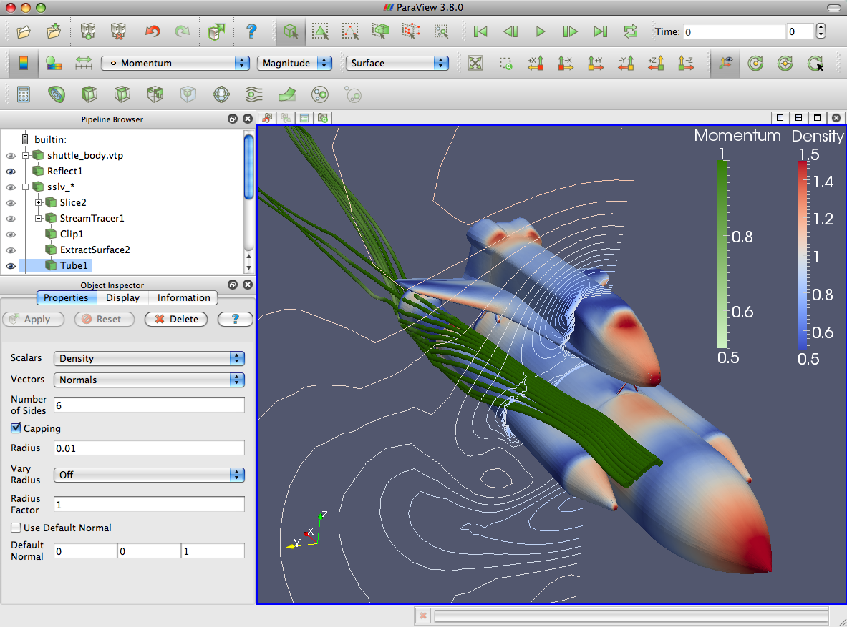
ParaView Application Architecture
ParaView Client
pvpython
Coprocessing
Qt Controls
Python Wrappings
ParaView Server
Parallel Abstractions and Controls
VTK
Core Visualization Algorithms
Notes:
ParaView client you may already be familiar with actually on a tall stack of software.

Slide 6
Traditional Visualization Workflow is Breaking Down
Solver
Full Mesh
Disk
Storage
Visualization
Image from Rob Ross,
Argonne National Laboratory
Notes:
The root problem is that rate of hard drive access is not growing at the same speed as computational rate.
W.r.t. the amount of data computed, we are writing proportionally less data to disk.
For a “hero-sized” petascale simulation run, we may not be able to write out or store enough data to do proper analysis.

Slide 7
What is the ParaView Coprocessing Library?
Simulation
ParaView Coprocessing
Notes:
The intension of the ParaView Coprocessing Library is to more directly couple analysis with the solver during simulation.
The ParaView Coprocessing Library is subservient to a running simulation that can make calls to do analysis while it runs.

Slide 8
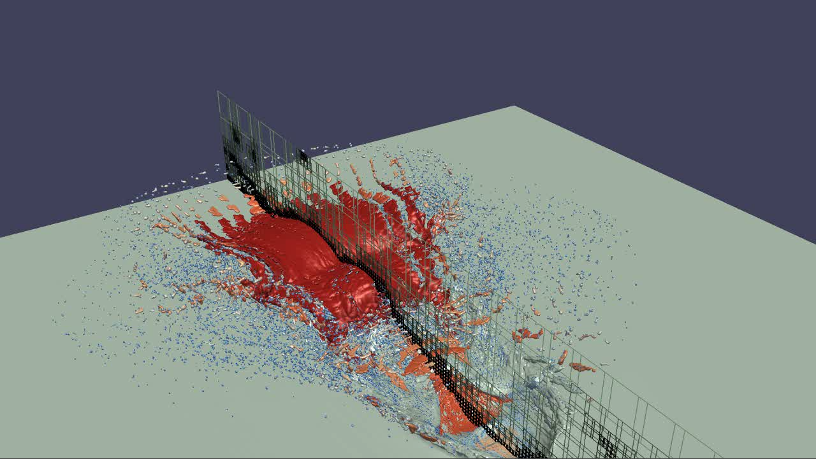
What is the ParaView Coprocessing Library?
Simulation
ParaView Coprocessing
Output Processed Data
Rendered Images
Notes:
The ParaView Coprocessing library outputs the results of its analysis.
A common desire is to render images of prepackaged visualizations.
Known as in-situ visualization.

Slide 9
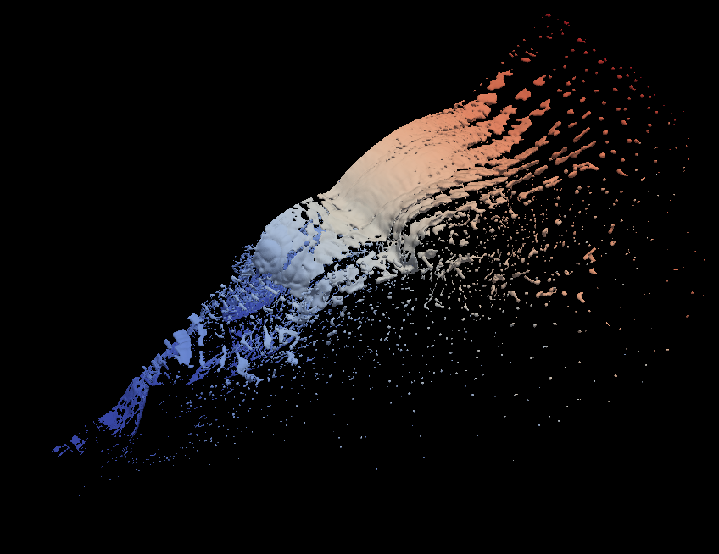
What is the ParaView Coprocessing Library?
Simulation
ParaView Coprocessing
Output Processed Data
Polygonal Output
with Field Data
Rendered Images
Notes:
But there are many more options when using the coprocessing library.
You can extract information in other ways that preserve the most relevant information but keep in a form that can still be interacted with.
For example, you could extract relevant polygonal surfaces. They are a fraction the size of the full mesh.

Slide 10
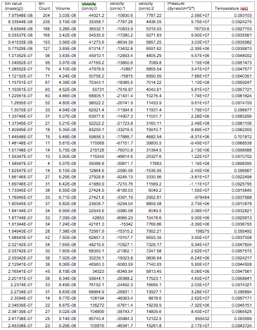
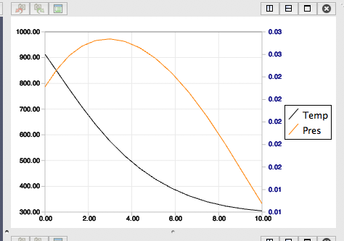
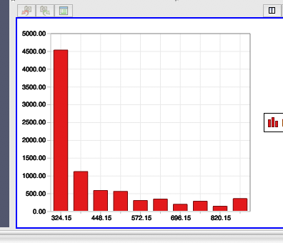
What is the ParaView Coprocessing Library?
Simulation
ParaView Coprocessing
Output Processed Data
Polygonal Output
with Field Data
Statistics
Series Data
Rendered Images
Notes:
You could also generate more statistical information for later charting.
One of the main advantages of the ParaView Coprocessing Library is that the algorithms available in the ParaView application are also available while coprocessing.

Slide 11
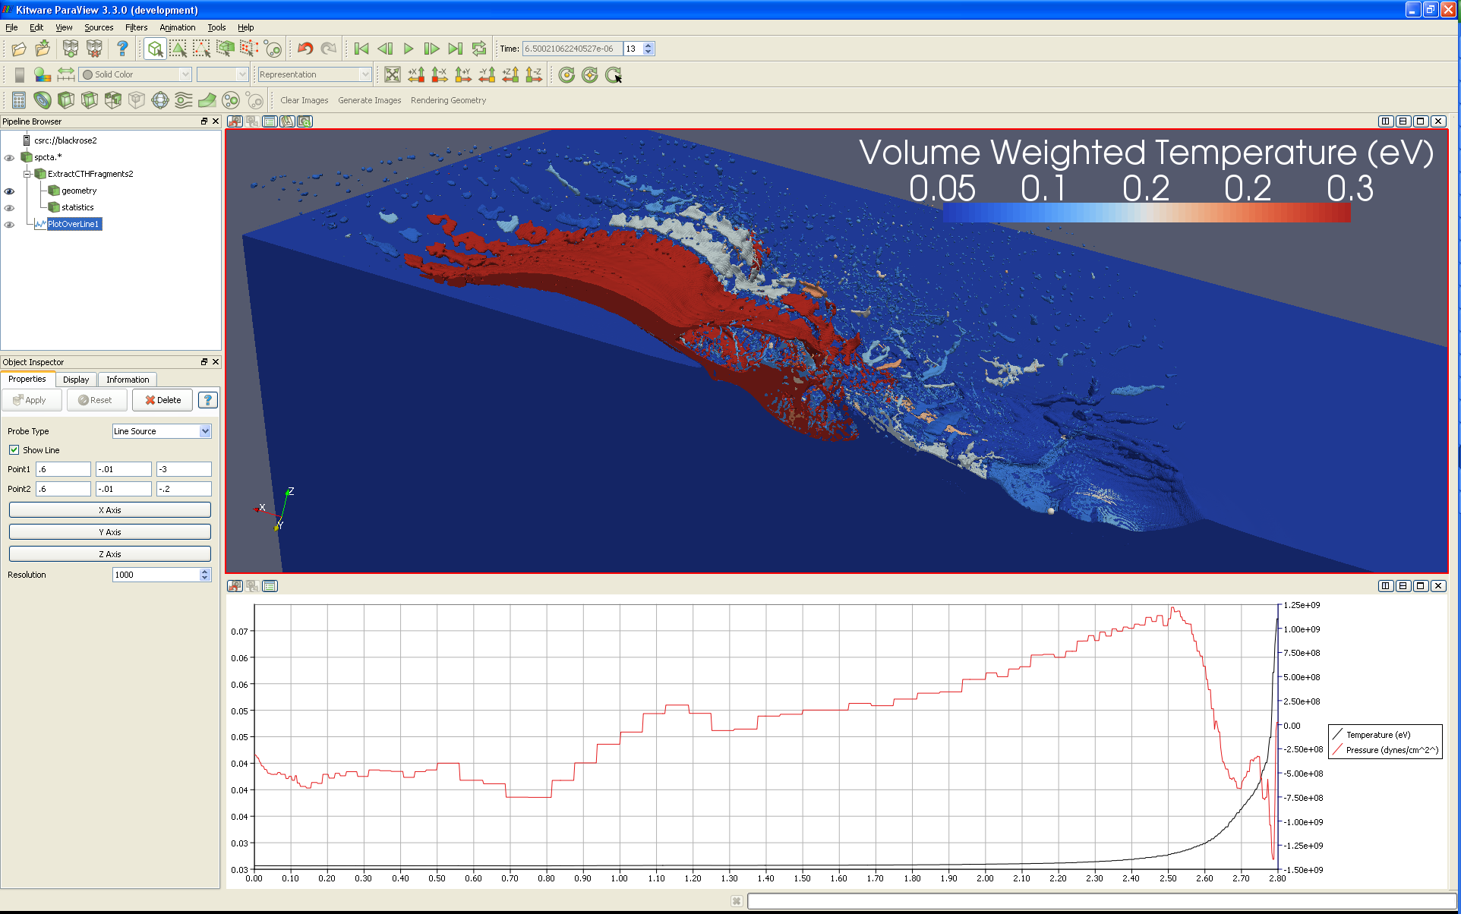
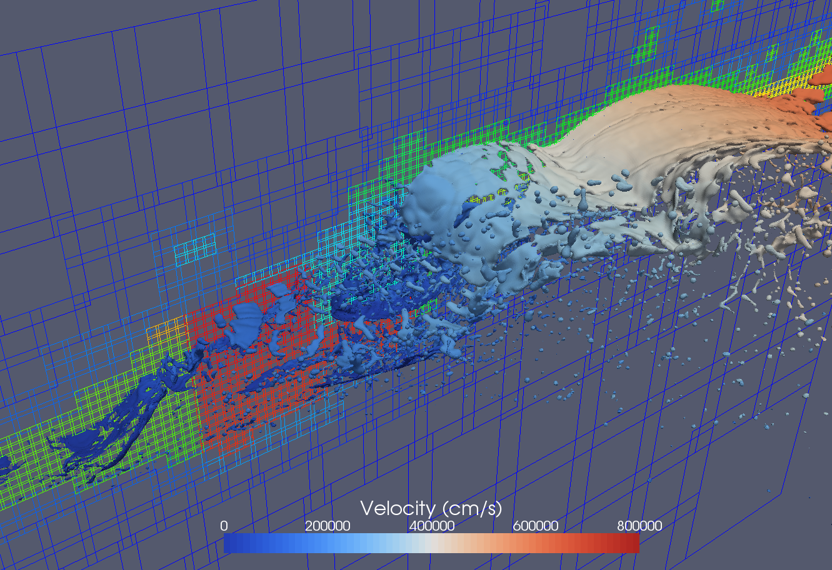
What is the ParaView Coprocessing Library?
# Create the reader and set the filename.
reader = servermanager.sources.Reader(FileNames=path)
view = servermanager.CreateRenderView()
repr = servermanager.CreateRepresentation(reader, view)
reader.UpdatePipeline()
dataInfo = reader.GetDataInformation()
pDinfo = dataInfo.GetPointDataInformation()
arrayInfo = pDInfo.GetArrayInformation("displacement9")
if arrayInfo:
# get the range for the magnitude of displacement9
range = arrayInfo.GetComponentRange(-1)
lut = servermanager.rendering.PVLookupTable()
lut.RGBPoints = [range[0], 0.0, 0.0, 1.0,
range[1], 1.0, 0.0, 0.0]
lut.VectorMode = "Magnitude"
repr.LookupTable = lut
repr.ColorArrayName = "displacement9"
repr.ColorAttributeType = "POINT_DATA"
Simulation
Augmented script in input deck.
Script Export
ParaView Coprocessing
Output Processed Data
Polygonal Output
with Field Data
Statistics
Series Data
Rendered Images
Notes:
Another advantage is that you can use the ParaView application to guide the coprocessing analysis.
From the ParaView application you can load a proxy geometry, define a desired analysis, and automatically generate a script understood by the ParaView Coprocessing Library.

Slide 12
What is the ParaView Coprocessing Library?
Notes:
Thus, for your end user, using the ParaView Coprocessing Library only a tiny step from using the ParaView application.
We will be demonstrating that today.

Slide 13
Solid Scaling Performance

Slide 14
Coprocessing Library
Solver
ParaView Server
function
calls
Adaptor
function
calls
Coprocessing API
Initialize()
AddPipeline(in pipeline)
RequestDataDescription(in time, out fields)
CoProcess(in vtkDataSet)
Finalize()
Notes:
To add coprocessing to a simulation solver, one writes an adaptor.
The adaptor is the only thing that has to be created to use coprocessing in a new piece of code.
The amount of code required for the adaptor is very small.
A significant portion of this tutorial is in creating adaptors.

Slide 15
Agenda
Overview
Quick Introduction to ParaView
The Coprocessing API
Creating VTK Data Objects
Binding to Fortran and C
Creating Pipelines
Python Scripts, Coprocessing Plugin, C++
Compiling Fun
Cross compiling, with/without shared libraries, with/without Python, minimizing memory footprint
Data Staging and Live Visualization

Slide 16
A Quick Introduction to ParaView

Slide 17
The Coprocessing API

Slide 18
Online Help
Email list: paraview@paraview.org.
Doxygen: http://www.paraview.org/ParaView3/Doc/Nightly/html/classes.html.
Wiki: http://paraview.org/Wiki/CoProcessing.
C++ example: http://paraview.org/Wiki/Coprocessing_example.
Python example: http://paraview.org/Wiki/Python_coprocessing_example.

Slide 19
Main Concepts
Perform coprocessing at end of time steps
CoProcessing should be as inexpensive as possible
Use shallow copies/reference counting of objects
Use existing arrays/memory
If no coprocessing is desired at end of time step then don’t bother creating/updating VTK data objects
May have multiple input grids/data objects
For users
Don’t know/care about internals
Nearly same complexity as using ParaView

Slide 20
Main CoProcessing Parts
Initialize
Check with the python script if coprocessing is necessary.
Input is simulation time and time step
Output is if coprocessing is needed along with needed grids and fields
Execute the coprocessing pipeline
Input the grid and field information
Execute the pipeline
Finalize

Slide 21
Initialize
C++
vtkCPProcessor
Can contain multiple coprocessing pipelines to be executed
vtkCPPythonScriptPipeline
A specific coprocessing pipeline to execute
Initialize(const char* pythonFileName)
Python
PYTHONPATH
LD_LIBRARY_PATH

Slide 22
Check if CoProcessing is Needed
vtkCPDataDescription
Set simulation time and time step
SetTime(double t)
SetTimeStep(vtkIdType i)
vtkCPProcessor::RequestDataDescription(vtkCPDataDescription*)
Return value indicates if coprocessing is needed
Query vtkCPDataDescription for grid and field information needed for this coprocessing step

Slide 23
Execute CoProcessing Output
Create/update VTK data objects in the adaptor
Must map VTK data objects to string key entered in ParaView coprocessing script creator plugin
Convention – “input” for single data objects
vtkCPDataDescription::GetInputDescriptionByName(“input”)
vtkCPInputDataDescription::SetGrid(vtkDataObject*)
Adaptor is responsible for creating and deleting the grids
Advanced
vtkCPInputDescription can contain which information to pass to the coprocessor

Slide 24
C++ Example
http://paraview.org/Wiki/Coprocessing_example

Slide 25
C++ Example (2)

Slide 26
Python Example
http://paraview.org/Wiki/Python_coprocessing_example
PYTHONPATH
<PARAVIEWDIR>/bin
<PARAVIEWDIR>/Utilities/VTKPythonWrapping/site-packages
LD_LIBRARY_PATH
<PARAVIEWDIR>/bin
import sys import mpi mpi.initialized() import paraview import paraview.vtk as vtk paraview.options.batch = True paraview.options.symmetric = True def _refHolderMaker(obj): def _refHolder(obj2, string): tmp = obj return _refHolder …

Slide 27
Python Example (2)
…
def coProcess(grid, simtime, simstep): import libvtkCoProcessorPython import <coprocessing script> as cpscript datadescription = \
libvtkCoProcessorPython.vtkCPDataDescription() datadescription.SetTimeData(simtime, simstep) datadescription.AddInput("input") cpscript.RequestDataDescription(datadescription) inputdescription = \
datadescription.GetInputDescriptionByName("input") if inputdescription.GetIfGridIsNecessary() == False: return import paraview.simple import paraview.vtk as vtk import paraview.numpy_support inputdescription.SetGrid(grid) cpscript.DoCoProcessing(datadescription) …

Slide 28
Python Example (3)
numsteps = 10 simulationtime = 12.3 for simstep in range(numsteps): simtime = simulationtime/float(numsteps-1) dataobject = <vtkDataObject Generator> coProcess(dataobject, simtime, simstep) mpi.finalized()
Adaptor efficiency suggestions:
Use numpy
Create a class derived from vtkObject with static member functions
Adding cells
Computing blanking

Slide 29
Creating VTK Objects

Slide 30
Getting Data Into the CoProcessor
Familiarity with VTK data objects.
Main object will derive from vtkDataObject
Grids that derive from vtkDataSet
Multiblock grids that contain multiple vtkDataSets
Field information
Point data – information specified for each point in a grid
Cell data – information specified for each cell in a grid
Field data – meta-data not associated with data set objects
All object groups are 0-based/C/C++ indexing

Slide 31
vtkDataSet Subclasses
vtkImageData
vtkUniformGrid
vtkPolyData
vtkRectilinearGrid
vtkUnstructuredGrid
vtkStructuredGrid

Slide 32
vtkImageData/vtkUniformGrid
SetDimensions() – number of points in each direction
SetSpacing() – cell lengths in each direction
SetOrigin() – location of point 0 (i=0, j=0, k=0)
Ordering for points and cells
Fastest in x-direction
Next in y-direction
Slowest in z-direction
vtkUniformGrid
Supports cell blanking
Currently written to file as vtkImageData

Slide 33
vtkRectilinearGrid
SetDimensions() – number of points in each direction
Set<X,Y,Z>Coordinates() – point coordinates in each direction
Ordering for points and cells
Fastest in x-direction
Next in y-direction
Slowest in z-direction

Slide 34
vtkPointSet/vtkStructuredGrid
SetPoints(vtkPoints*) – set the number and coordinates of the points
vtkPoints class
C/C++ indexing
SetDataTypeTo<Int,Float,Double>()
SetNumberOfPoints() – allocation
SetPoint() – fast but doesn’t do bounds checking
InsertPoint()/InsertNextPoint() – safe but does bounds checking and allocation as needed
vtkStructuredGrid::SetDimensions()
Other derived classes: vtkPolyData, vtkUnstructuredGrid
vtkStructuredGrid

Slide 35
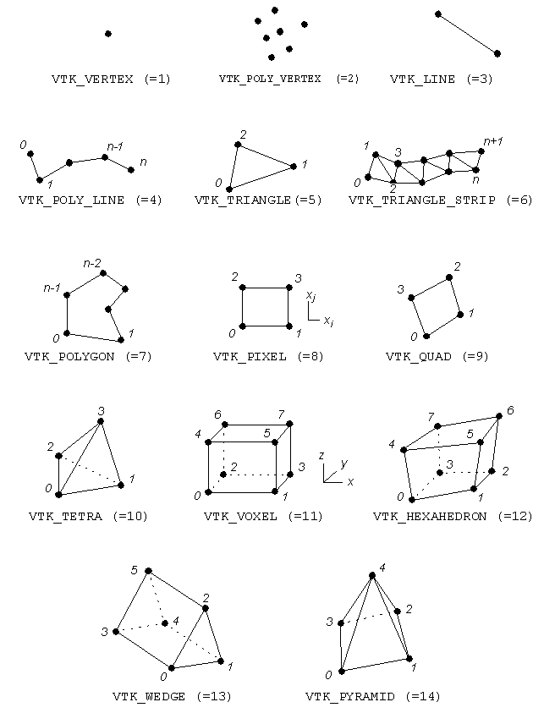
vtkCell Straight-Edged Types

Slide 36
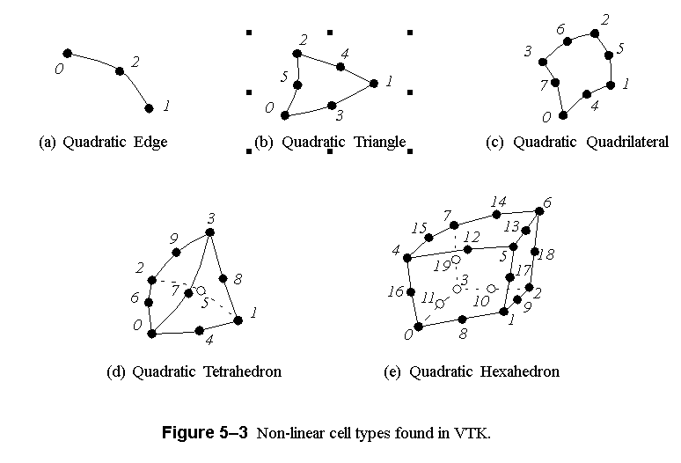
vtkCell Curvilinear-Edged Types

Slide 37
vtkPolyData Cells
Efficient way – build through vtkCellArray
vtkCellArray::SetNumberOfCells()
Done for verts, lines, polys, triangle strips
Simple way – build through poly data API
Allocate()
InsertNextCell()
Squeeze() – reclaim unused memory
WARNING – Order that cells are added may be different than they are accessed
Ordered by verts, lines, polys, triangle strips
Need to match with cell data

Slide 38
vtkUnstructuredGrid Cells
Order of cells is order of insertion
0-based indexing
Allocate()
InsertNextCells()
SetCells()
Squeeze()
Inserted points of cells are 0-based indexing

Slide 39
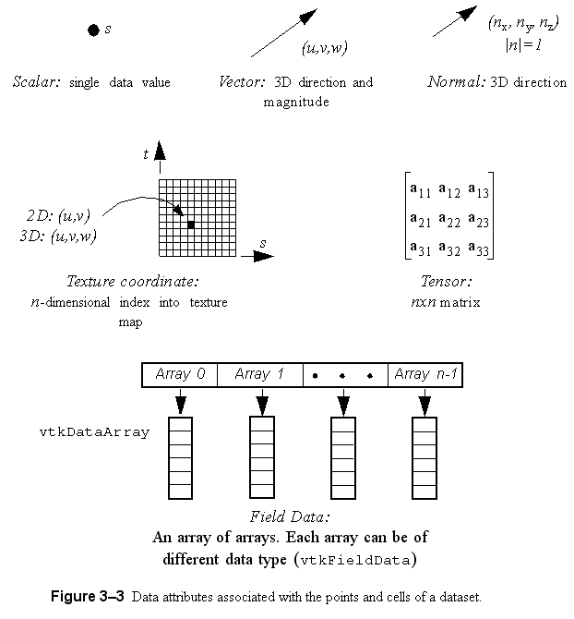
Field Information
Store information defined over grids
Stored in concrete classes that derive from vtkDataArray
vtkFloatArray
vtkIntArray
vtkDoubleArray
vtkUnsignedCharArray
…

Slide 40
vtkDataArray : Basis for vtkDataObject Contents
tuple 0
An array of n tuples
Each tuple has m components
Internal implementation is a pointer to an n x m block of memory
Data type determined by class
Two APIs : generic , specific
tuple n-1

Slide 41
vtkDataArray
SetNumberOfComponents() – call first
SetNumberOfTuples()
For point data must be set to number of points
For cell data must be set to number of cells
SetArray()
If flat array has proper component & tuple ordering use existing memory – most efficient
Can specify who should delete
VTK uses pipeline architecture so coprocessing library will NOT modify array values
SetTupleValue() – uses native data type
SetValue() – uses native data type
SetName()

Slide 42
vtkFieldData
Object for storing vtkDataArrays
vtkDataSet::GetFieldData() – non-grid associated arrays
Derived classes
vtkPointData – vtkDataSet::GetPointData()
vtkCellData – vtkDataSet::GetCellData()
vtkFieldData::AddArray()
Specific arrays are normally retrieved by name from vtkFieldData
Uniqueness is not required but can cause unexpected results

Slide 43
vtkCompositeDataSet
Way to combine multiple vtkDataSets into a single VTK structure
vtkMultiBlockDataSet
Block structure must be the same on each process
Block is null if data set is on a different process
SetNumberOfBlocks()
SetBlock()
vtkHierarchicalBoxDataSet
AMR data sets using vtkUniformGrids
SetNumberOfLevels()
SetNumberOfDataSets()
SetDataSet()

Slide 44
Grid Partitioning
For unstructured grids and polydatas
Single data set per process – use as is
Multiple data sets per process – choice of combining or not depends on memory layout
For topologically structured grids
Must be partitioned into logical blocks
Order is important in specifying grid parameters
First call SetExtents()
Index of first and last point in each direction
Will be different on each process
SetDimensions() – same on each process

Slide 45
vtkUnstructuredGrid Example
void CreateGrid(vtkCPDataDescription* dataDescription, int numPoints, double* coordsArray, int numCells, int* cellConnectivity, double* dofArray) { vtkUnstructuredGrid* grid = vtkUnstructuredGrid::New(); vtkPoints* nodePoints = vtkPoints::New(); vtkDoubleArray* coords = vtkDoubleArray::New(); coords->SetNumberOfComponents(3); coords->SetNumberOfTuples(numPoints); for(int i=0;i<*numPoints;i++) { double tuple[3] = {coordsArray[i],
coordsArray[i+numPoints], coordsArray[i+numPoints*2]}; coords->SetTupleValue(i, tuple); } nodePoints->SetData(coords); coords->Delete(); grid->SetPoints(nodePoints); nodePoints->Delete(); …

Slide 46
vtkUnstructuredGrid Example (2)
Only tetrahedra in this example
Canonical ordering of tetrahedra is same in simulation data structures and VTK
… vtkIdType pts[4]; for(int iCell=0;iCell<numCells;iCell++) { for(int i=0;i<4;i++) { pts[i] = cellConnectivity[iCell+i*numCells]; } grid->InsertNextCell(VTK_TETRA, 4, pts); } dataDescription->GetInputDescriptionByName("input")
->SetGrid(grid); grid->Delete(); …

Slide 47
vtkUnstructuredGrid Example (3)
…
vtkCPInputDataDescription* idd = dataDescription->GetInputDescriptionByName("input"); if(idd->IsFieldNeeded("velocity")) { vtkDoubleArray* velocity = vtkDoubleArray::New(); velocity->SetName("velocity"); velocity->SetNumberOfComponents(3); velocity->SetNumberOfTuples(numPoints); for (vtkIdType idx=0; idx<numPoints; idx++) { velocity->SetTuple3(idx, dofArray[idx],
dofArray[idx+ numPoints], dofArray[idx+ 2*numPoints]); } grid->GetPointData()->AddArray(velocity); velocity->Delete(); } if(idd->IsFieldNeeded("pressure")) { vtkDoubleArray* pressure = vtkDoubleArray::New(); pressure->SetName("pressure"); pressure->SetArray(dofArray+3*numPoints, numPoints, 1); grid->GetPointData()->AddArray(pressure); pressure->Delete(); } }

Slide 48
Binding to Fortran and C

Slide 49
Adaptor Strategy
Use existing/create flat arrays in C/Fortran code
Create VTK data objects in C++ code
vtkDataArrays can use existing memory without CoProcessing library modifying it
API at ParaView/CoProcessing/Adaptors/FortranAdaptors/FortranAdaptorAPI.h
Use CMake to simplify the build process
BUILD_COPROCESSING_ADAPTORS ->on

Slide 50
FortranAdaptorAPI.h
Fortran to C/C++ bindings – call xyz()
Lower case C/C++ function names
Add underscore to end of function name – void xyz_()
Unchanged – void xyz()
Upper case C/C++ function name – void XYZ()
extern "C" void coprocessorinitialize_(char* pythonFileName, int* pythonFileNameLength);
Creates a static vtkCPProcessor object and sets the python script file name
Creates a vtkCPDataDescription object and adds in an input with name “input”
extern "C" void coprocessorfinalize_();
Deletes vtkCPProcessor and vtkCPDataDescription objects

Slide 51
FortranAdaptorAPI.h (2)
extern "C" void requestdatadescription_(int* timeStep, double* time, int* coprocessThisTimeStep);
Checks with the python coprocessing script whether or not to process for input timeStep and time
Sets coprocessThisTimeStep
1 – do coprocessing
0 – skip coprocessing

Slide 52
FortranAdaptorAPI.h (3)
extern "C" void needtocreategrid_(int* needGrid);
Checks whether or not a grid has been created and added to the vtkCPDataDescription object
Assumes the grid is static
Sets needGrid
1 – need to create the grid
0 – a grid exists
Clears field data from the created grid
extern "C" void coprocess_();
Only need to call if coprocessing is requested
Must create grid and set field information first
Runs the python coprocessing script

Slide 53
FortranAdaptorAPI.h (4)
Helper functions:
vtkCPDataDescription* GetCoProcessorData();
Access to a static vtkCPDataDescription object
void ClearFieldDataFromGrid(vtkDataSet* grid);
Assumes grid is static but field information is changing
bool ConvertFortranStringToCString(char* fortranString, int fortranStringLength, char* cString, int cStringMaxLength);
C/C++ code doesn’t know when Fortran strings end

Slide 54
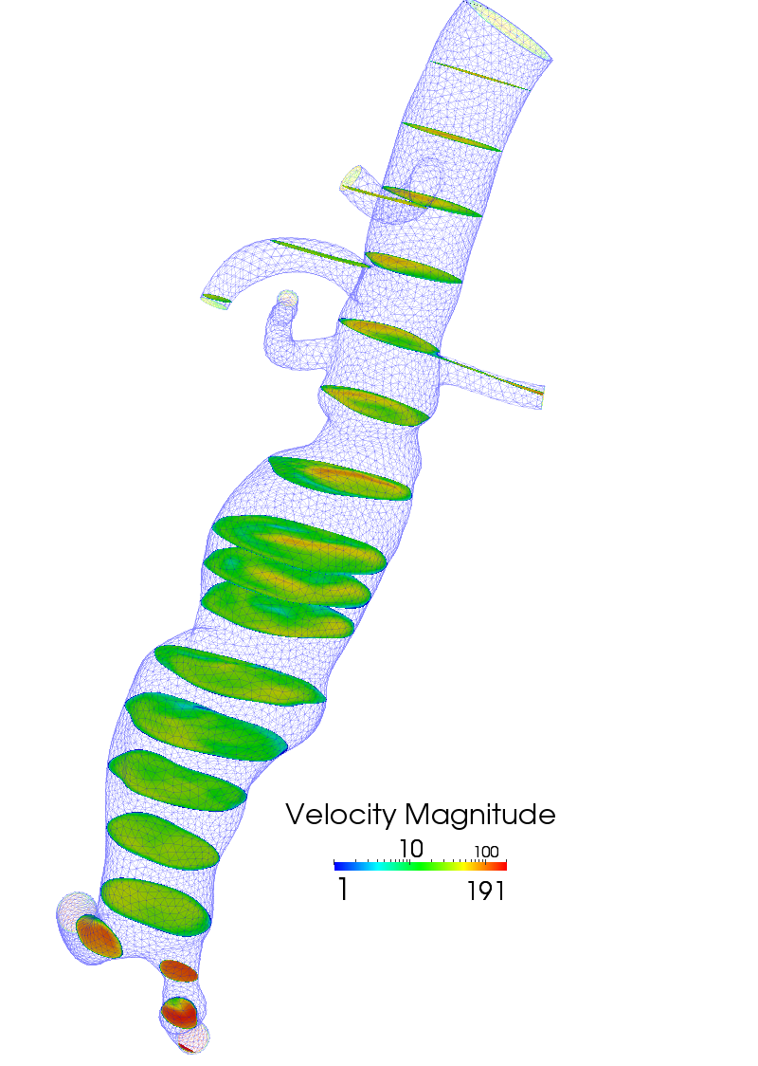
PHASTA Example
ParaView/CoProcessing/Adaptors/FortranAdaptors/PhastaAdaptor
phastaadaptor.f
Creates the flat arrays from PHASTA data structures
PHASTA blocks some information for cache efficiency
PhastaAdaptor.cxx
Similar to the vtkUnstructured example shown earlier
Single unstructured grid per block
Scalar temperature and pressure arrays just reference PHASTA memory

Slide 55
Creating Pipelines

Slide 56
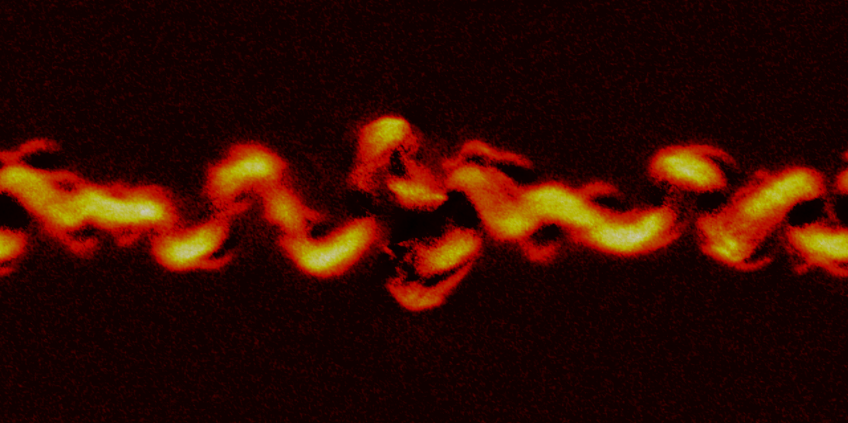
NPIC
Particle-in-Cell method
Code used to analyze “plasma instability”

Slide 57
… (MPI_INIT, simulation initialization) ! Open the coprocessor on each node call coprocessorinitialize("script.py", 9) … ! Take a time Step and output do while ( t < tmaxwpe .and. elapsed_time < quota .and. continue_calculation ) ! Track time and iteration step t=t+dt it=it+1 … ! Output moments and fields at regular interval it=noutput if (mod(it,noutput) == 0) then call output call mode_structure(modes) endif … ! close out the coprocessor call coprocessorfinalize … (MPI_FINALIZE, etc)
! Check if coprocessing will be necessary call requestdatadescription(it, t, docoprocess) if (docoprocess .ne. 0) then call needtocreategrid(needgrid) if (needgrid .ne. 0) then call createstructuredgrid(myid, nx, ny_start, ny_stop,…) endif endif … ! adding variables here … if (docoprocess .ne. 0) then call coprocess endif
Notes:
Find the existing initialization routines and toss in coprocessorinitialize (currently simplified to find “script.py”)
Where the output goes there goes the insitu

Slide 58
CoProcessing/Adaptors/FortranAdaptors/NPICAdaptor
extern "C" void createstructuredgrid_( int *myid, int *xdim, int *ystart, int *ystop, double *xspc, double *yspc) { if(!GetCoProcessorData()) { vtkGenericWarningMacro("Unable to access CoProcessorData."); return; } vtkMultiBlockDataSet* grid = vtkMultiBlockDataSet::New (); grid->SetNumberOfBlocks (1); vtkImageData* img = vtkImageData::New (); img->Initialize (); grid->SetBlock (0, img); img->Delete (); img->SetSpacing (*xspc, *yspc, 0.0); // Offsets account for a ghost point on either end in both directions // They also account for the 1 base in Fortran vs the 0 base here. img->SetExtent (-1, *xdim, ystart[*myid] - 2, ystop[*myid], 0, 0); img->SetOrigin (0.0, 0.0, 0.0); GetCoProcessorData()->GetInputDescriptionByName("input")->SetGrid(grid); grid->Delete (); }

Slide 59
! Now collect each desired quantities and output call write_data(1,field(1,:,:)) call write_data(2,field(2,:,:)) call write_data(3,field(3,:,:)) call write_data(4,field(4,:,:)) call write_data(5,field(5,:,:)) call write_data(6,field(6,:,:)) call write_data(7,ax) call write_data(8,ay) call write_data(9,az) call write_data(10,diva) call write_data(11,phi) call write_data(12,jx(1:nx2,1:ny2)) call write_data(13,jy(1:nx2,1:ny2)) call write_data(14,jz(1:nx2,1:ny2)) call write_data(15,rho(1:nx2,1:ny2)) call write_data(16,moment(4,1:nx2,1:ny2,1)) call write_data(17,moment(1,1:nx2,1:ny2,1)) call write_data(18,moment(2,1:nx2,1:ny2,1)) call write_data(19,moment(3,1:nx2,1:ny2,1)) call write_data(20,moment(4,1:nx2,1:ny2,2)) call write_data(21,moment(1,1:nx2,1:ny2,2)) call write_data(22,moment(2,1:nx2,1:ny2,2)) call write_data(23,moment(3,1:nx2,1:ny2,2))
! Add the fields from write_data if (docoprocess .ne. 0) then call add_vector ("E", 1, field(1,:,:), field(2,:,:), field(3,:,:), nx2*ny2); call add_vector ("B", 1, field(4,:,:), field(5,:,:), field(6,:,:), nx2*ny2); call add_vector ("a", 1, ax, ay, az, nx2*ny2); call add_scalar ("diva", 4, diva, nx2*ny2); call add_scalar ("phi", 3, phi, nx2*ny2); call add_vector ("j", 1, jx(1:nx2,1:ny2), jy(1:nx2,1:ny2), jz(1:nx2,1:ny2), nx2*ny2); call add_scalar ("rho", 3, rho(1:nx2,1:ny2), nx2*ny2); call add_scalar ("ne", 2, moment(4,1:nx2,1:ny2,1), nx2*ny2); call add_scalar ("ni", 2, moment(4,1:nx2,1:ny2,2), nx2*ny2); call add_vector ("Ve", 2, moment(1,1:nx2,1:ny2,1), moment(2,1:nx2,1:ny2,1), moment(3,1:nx2,1:ny2,1), nx2*ny2); call add_vector ("Vi", 2, moment(1,1:nx2,1:ny2,2), moment(2,1:nx2,1:ny2,2), moment(3,1:nx2,1:ny2,2), nx2*ny2); endif

Slide 60
CoProcessing/Adaptors/FortranAdaptors/NPICAdaptor
extern "C" void add_scalar_(char *fname, int *len, double *data, int *size) { vtkDoubleArray *arr = vtkDoubleArray::New (); vtkStdString name (fname, *len); arr->SetName (name); arr->SetNumberOfComponents (1); arr->SetArray (data, *size, 1); vtkDataObject *obj =
GetCoProcessorData()->GetInputDescriptionByName ("input")->GetGrid (); vtkMultiBlockDataSet *grid = vtkMultiBlockDataSet::SafeDownCast (obj); vtkDataSet *dataset = vtkDataSet::SafeDownCast(grid->GetBlock (0)); dataset->GetPointData ()->AddArray (arr); arr->Delete (); }

Slide 61
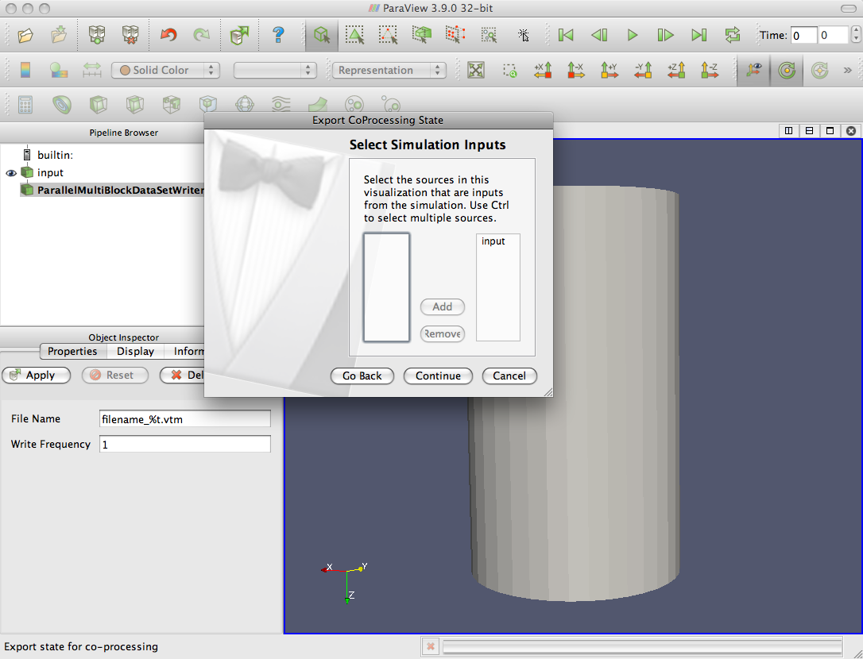
Exporting from ParaView
Interact with ParaView normally
Export a script that mimics that interaction
Runs during each coprocessing step
(one frame at a time)

Slide 62
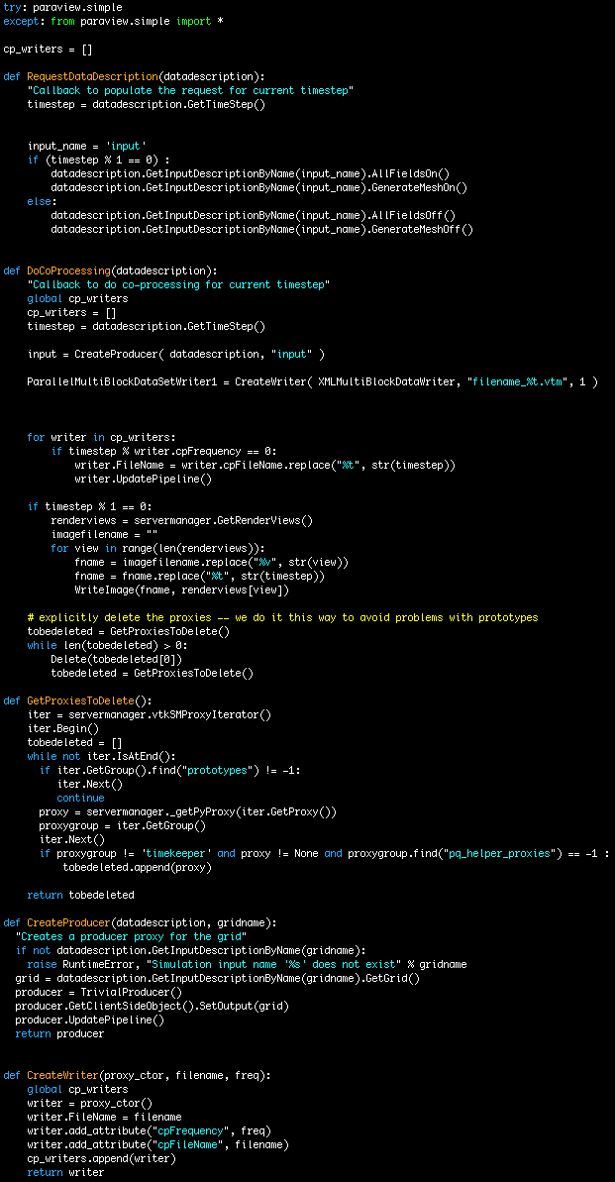
Bootstrapping
def DoCoProcessing(datadescription): … input = CreateProducer( datadescription, "input" ) ParallelMultiBlockDataSetWriter1 = CreateWriter( XMLMultiBlockDataWriter, "filename_%t.vtm", 1)

Slide 63
Demonstration

Slide 64
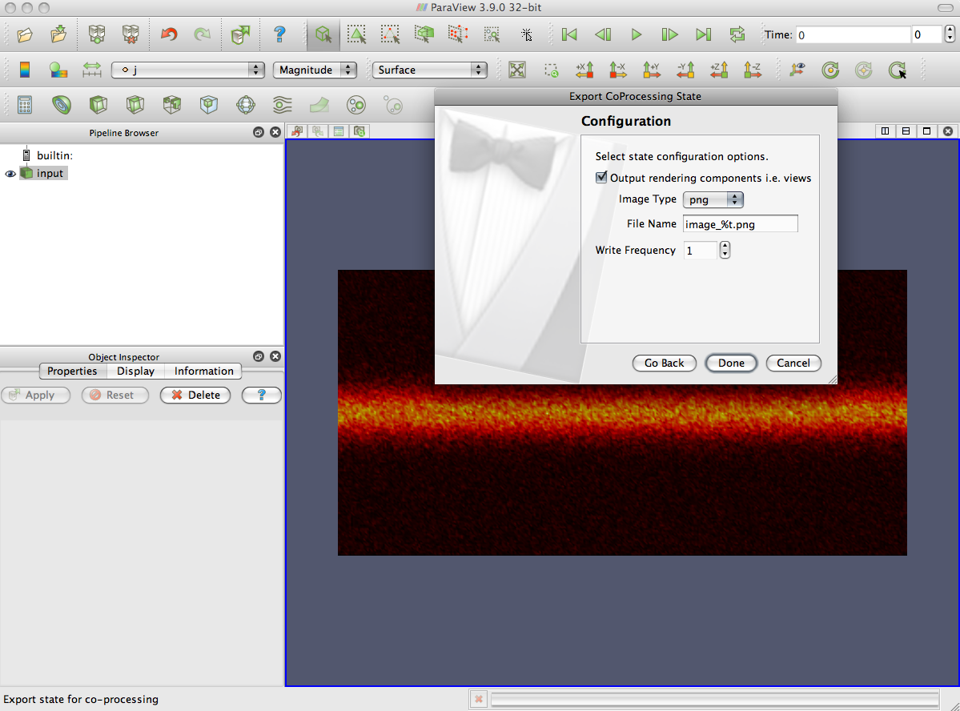
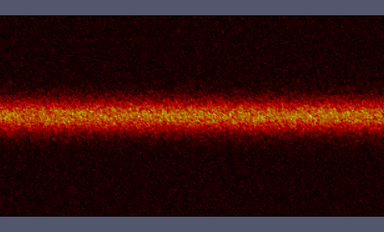
First Useful Image
RenderView1.CameraPosition = [18.6328125, 37.3828125, 134.3787411685681] … RenderView1.CameraFocalPoint = [18.6328125, 37.3828125, 0.0] … RenderView1.Background = [0.31999694819562063, 0.34000152590218968, 0.42999923704890519]
a3_j_PVLookupTable = GetLookupTableForArray( "j", 3, Discretize=1, RGBPoints=[0.00029873965903074048, 0.0, 0.0, 0.0, 0.077298959436258918, 0.90196078431372551, 0.0, 0.0, 0.1542991792134871, 0.90196078431372551, 0.90196078431372551, 0.0, 0.19279928910210117, 1.0, 1.0, 1.0], UseLogScale=0, VectorComponent=0, NumberOfTableValues=256, ColorSpace='RGB', VectorMode='Magnitude', HSVWrap=0, ScalarRangeInitialized=1.0, LockScalarRange=0 )

Slide 65
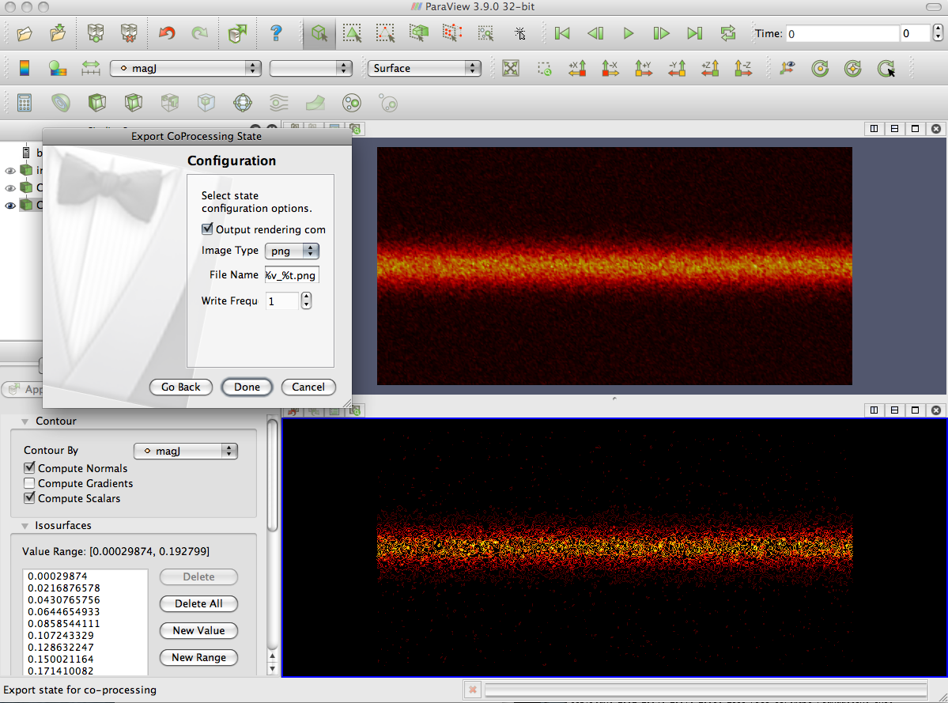
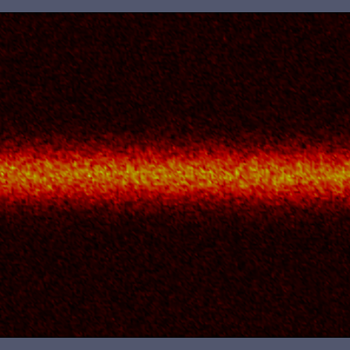
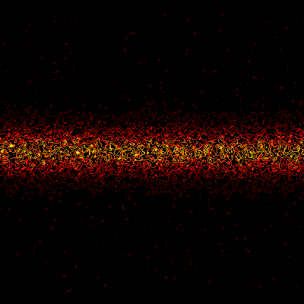
Two Images

Slide 66
Scale it up!
2 Processors!
Demonstration
Quite often no modification is needed
including if the input changes refinement
NPIC we have to move the camera, details aren’t interesting.

Slide 67
Summary So Far
Write a simple output at small scale
Pull it into paraview and set things up
Test it out on the small scale run
Scale it up (modulo some changes)
I’ve run the same script on 2 cores to 2048 cores.

Slide 68
What if we don’t want python
Many large machines don’t do dynamic loading
Great to use for static, lower overhead
Not necessary to skip python—Stay tuned!
It’s much more manual than exporting from Paraview.

Slide 69
Creating a C++ pipeline
int vtkHCPipeline::CoProcess(vtkCPDataDescription* dataDescription) { int timeStep = dataDescription->GetTimeStep (); vtkTrivialProducer *prod = vtkTrivialProducer::New (); prod->SetOutput ( dataDescription->GetInputDescriptionByName ("input")
->GetGrid ()); vtkPXMLMultiBlockDataWriter *writer =
vtkPXMLMultiBlockDataWriter::New ();
writer->SetInputConnection (prod->GetOutputPort ()); char filename[64]; sprintf (filename, "output_%d.vtm", timeStep); writer->SetFileName (filename); writer->Update (); prod->Delete (); writer->Delete (); }

Slide 70
Swapping Out Adaptors/FortranAPI
void coprocessorinitialize_(char* pythonFileName, int* pythonFileNameLength ) { if(!coProcessor) { char cPythonFileName[200]; ConvertFortranStringToCString(
pythonFileName, *pythonFileNameLength,
cPythonFileName, 200); vtkCPPythonScriptPipeline* pipeline =
vtkCPPythonScriptPipeline::New(); pipeline->Initialize(cPythonFileName); coProcessor = vtkCPProcessor::New(); coProcessor->Initialize(); coProcessor->AddPipeline(pipeline); pipeline->Delete(); } if(!coProcessorData) { coProcessorData =
vtkCPDataDescription::New(); coProcessorData->AddInput("input"); } }
void coprocessorinitialize_()
{ if(!coProcessor) {
vtkHCPipeline* pipeline =
vtkHCPipeline::New (); coProcessor = vtkCPProcessor::New(); coProcessor->Initialize(); coProcessor->AddPipeline(pipeline); pipeline->Delete(); } if(!coProcessorData) { coProcessorData =
vtkCPDataDescription::New(); coProcessorData->AddInput("input"); } }
Don’t forget extern “C”

Slide 71
Summary
Generating pipelines in python is great workflow
But in real situations the overhead of compiling python may be too much
Use C++ to really specialize what you link in from paraview
Pat will talk about how to specialize Paraview further to get the compile size down.

Slide 72
Compiling Fun

Slide 73
Cross compiling
Why / when should we cross compile?
- when target platform does not support a compiler environment
- microcontrollers, embedded systems
- supercomputers
Native, or build platform vs. target, or host platform

Slide 74
Cross compiling
Need headers and libraries for target platform
Need to restrict search paths when configuring build

Slide 75
Cross compiling
Configure time tests
- Try compile
- example: check if symbol exists
- no problem
- Try run
- example: check if char is signed
- can’t do it! Test must run on target platform

Slide 76
Cross compiling
Problem: compile time code execution
Example, python wrapping:
- Compile a helper executable
- Helper writes generated source files
- Generated source files are compiled
Solution:
- Compile helper executables natively
- Invoke native executables while cross compiling

Slide 77
Cross compiling with CMake
CMake is a configure tool, writes Makefiles
To cross compile, specify a toolchain file:
cmake –D CMAKE_TOOLCHAIN_FILE=/path/to/toolchain.cmake
Toolchain file specifies target platform, compilers, search paths, default flags

Slide 78
Cross compiling with CMake
Handling Try Run tests:
CMake generates a file with the command line of the Try Run test it wants to execute
User executes Try Run tests by hand, types result into generated file for CMake to read
ParaView is distributed with TryRunResults files for popular target platforms

Slide 79
Cross compiling with CMake
Handling compile time code execution in CMake
Configure the project twice: native and cross compile
For native build, compile only the helper executables
During cross compile, use native executables

Slide 80
Cross compiling with CMake
# Invoke a python wrapper executable to generate a new source file
# and then create a library with the generated source file
add_custom_command(
OUTPUT myClassPython.cpp
DEPENDS pythonWrapper myClass.cpp
COMMAND pythonWrapper
ARGS myClass.cpp)
add_library(mymodule myClassPython.cpp)

Slide 81
Cross compiling with CMake
# Create the python wrapper executable
if(NOT CMAKE_CROSSCOMPILING)
add_executable(pythonWrapper pythonWrapper.c)
else()
add_executable(pythonWrapper IMPORTED)
set_target_properties(pythonWrapper
PROPERTIES IMPORTED_LOCATION "/path/to/pythonWrapper")
endif()

Slide 82
Cross compiling with CMake
if(CMAKE_CROSSCOMPILING)
find_package(HostTools REQUIRED)
else()
add_custom_target(HostTools)
endif()
if(NOT CMAKE_CROSSCOMPILING)
add_executable(pythonWrapper pythonWrapper.c)
export(TARGETS pythonWrapper FILE HostTools.cmake APPEND)
add_dependencies(HostTools pythonWrapper)
endif()
make HostTools

Slide 83
Cross compiling with CMake
CMake discovers MPI headers and libraries
CMake invokes mpi compiler wrapper to determine required paths and libraries
mpicxx –show

Slide 84
Static python linking
A simple python module example
import mymodule
mymodule.say_hello()
Pure python module: mymodule.py
Extension module: mymodule.so
mymodule.so is dynamically loaded
contains C function: void initmymodule()

Slide 85
Static python linking
#include <Python.h>
int main() {
Py_Initialize();
const char* code = "import mymodule \n"
"mymodule.say_hello() \n";
PyRun_SimpleString((char*)code);
Py_Finalize();
}

Slide 86
Static python linking
#include <Python.h>
extern void initmymodule();
int main() {
PyImport_AppendInittab(" mymodule ", initmymodule);
Py_Initialize();
const char* code = "import mymodule \n"
"mymodule.say_hello() \n";
PyRun_SimpleString((char*)code);
Py_Finalize();
}
executable now has a dependency on mymodule.so

Slide 87
Static python linking
Use static linking to avoid shared library dependencies
Must compile python statically
configure –disable-shared
libpython2.6.a instead of libpython2.6.so
Python standard library includes many extension modules
want to compile math.c into libpython2.6.a, instead of producing math.so

Slide 88
Static python linking
After configuring python, edit file Modules/Setup to indicate which modules should be included as part of libpython2.6.
Or, use CMake! CMake handles static extension modules and cross compiling
CMakified version of python 2.5 is available

Slide 89
Minimizing executable size
pvbatch is a paraview server and python batch client
includes python, mesa rendering, mpi
pvbatch static executable is 130 MB using ibm xlC cross compiler
Coprocessor library therefore adds 130 MB

Slide 90
Minimizing executable size
Leverage static linking to determine minimal set of object code required
Linker will copy relevant sections of archive libraries into final executable based on symbols referenced

Slide 91
Minimizing executable size
Problem: wrapper layers reference almost all the code in a library
Paraview wrappers:
python
client server
instantiator

Slide 92
Minimizing executable size
If we knew which functions would be invoked by the wrappers then we could use just a subset of the wrappers
Compile with full wrappers, run coprocessing routine, debugging printf’s write all wrapper invocations to a file
Tool parsers the debug file and generates a header file that references the minimal set of wrappers required

Slide 93
Minimizing executable size
Recompile using minimal required wrappers
130 MB → 25 MB
Issue: if you change your coprocessing routine you may require wrappers that are not available

Slide 94
Data Staging and Live Visualization

Slide 95
Data staging and live visualization
Introduction
Use cases

Slide 96
Data staging and live visualization
Start simulation + coprocessor on supercomputer

Slide 97
Data staging and live visualization
Start pvserver on vis cluster

Slide 98
Data staging and live visualization
Launch paraview client, connect to pvserver

Slide 99
Data staging and live visualization
Create Live Data Source, pvserver now communicates with the coprocessor

Slide 100
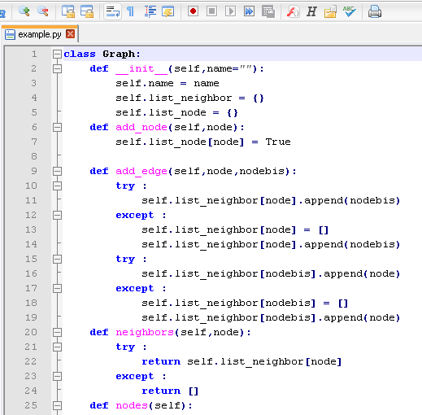
Data staging and live visualization
Or, run paraview python client (pvpython) directly on vis cluster
Python client issues commands to pvserver
For example: write data to disk whenever new data arrives

Slide 101
Data staging and live visualization
Paraview can apply additional visualization, rendering, animation to staged data

Slide 102
Data staging and live visualization
Paraview can apply additional visualization, rendering, animation to staged data

Slide 103
Data staging and live visualization
Initiating the connection between
the coprocessor and pvserver
Coprocessor method RequestDataDescription is called each timestep
Coprocessor (process 0 only) tries to initiate a connection to pvserver
Check socket using hardcoded host:port
Check existence of a file containing host:port
If no connection is made, no coprocessing is required for this timestep

Slide 104
Data staging and live visualization
Initiating the connection between
the coprocessor and pvserver
Process 0 of coprocessor successfully connects to process 0 of pvserver on vis cluster
Coprocessor discovers number of pvserver processes and host:port information for each
Coprocessor initiates multiple socket connections to pvserver
Multiple strategies here
Want to saturate network

Slide 105
Data staging and live visualization
Coprocessor method DoCoProcessing is called
After executing the pipeline the pipeline sinks (data extracts) are sent to pvserver
Replace writers with socket sends

Slide 106
Data staging and live visualization
Pipeline state description (xml) is sent to pvserver
XML is forwarded to paraview client
User can manipulate the state using standard object inspector panels & widgets
Modified state is sent to coprocessor (via pvserver)
Next time coprocessor is executed it receives and uses the modified state

Slide 107
Data staging and live visualization
Each timestep new data accumulates on pvserver
The Live Data Source presents the data as a time series
Can use animation controls to step forward and back
Can specify limit on the number of cached timesteps

Slide 108
Data staging and live visualization
Different strategies for data transfer
coprocessor → pvserver
Data aggregation on coprocessor before sends
Threads to listen on multiple sockets per pvserver process
GLEAN library from Argonne National Laboratory

