Slide 1
SimpleITK
Cause I had to do the slides...

Slide 2
SimpleITK: User Perspective

Slide 3
Under the hood

Slide 4
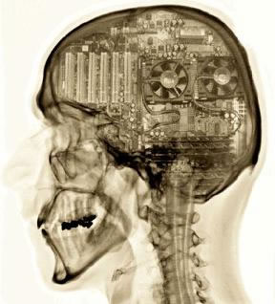
Status
“Guts” completed (mostly)
Registration missing
Extensible framework
Tier 1
C++, Python, Java
Tier 2
Tcl, Lua, Ruby, Perl?
Tier 3
R, C# (hoping to promote)

Slide 5
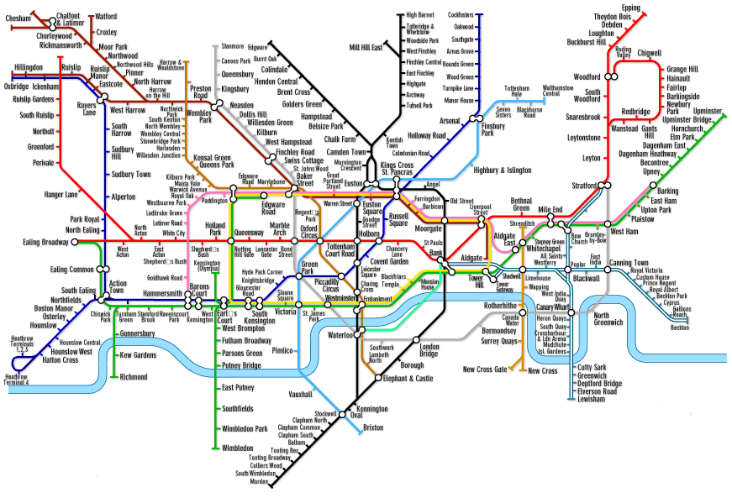
Plans
Distribution
Native packages, C++, Java, Python
Polish
Documentation
MICCAI Tutorial
MI Tutorial?

